Slide 1
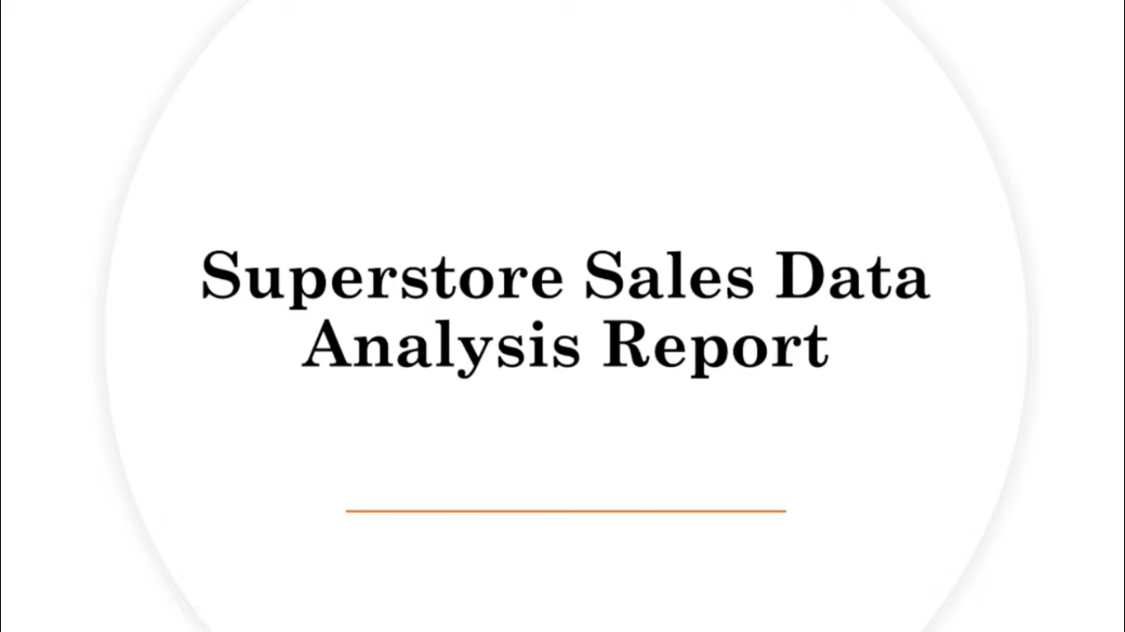

Slide 2
Superstore Sales Analysis:-
A data-driven overview of sales, profit, and customer insights.

Slide 3
Objective:-
To analyze Superstore sales data
Identify key profit drivers and loss areas
Understand regional and category performance
Provide actionable insights for business growth

Slide 4
About Dataset:-
Contains order-level data for multiple years
Key attributes: Sales, Profit, Discount, Quantity, Category, Segment, Region, etc.
Source: Superstore Dataset (Sample from Kaggle)

Slide 5
Data Overview:-
Metric | Value
Total Orders | 9994
Total Sales | $2.3M
Total Profit | $286K
Average Discount | 15%

Slide 6
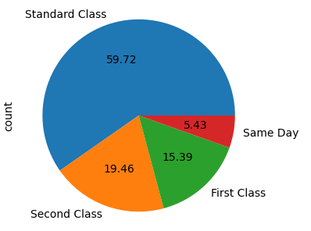
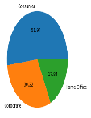
Shipping Methods:-
What is the popular Shipping Mode?
Standard Class 59.72%
Second Class 19.46%
First Class 15.39%
Same Day 5.43%

Slide 7

Customer Segmentation:-
Customer segment with highest number of segmentation?
Total Customers : 9994
Group customer based on segments:-
51.94% Consumer
30.22% Corporate
17.84% Home Office

Slide 8
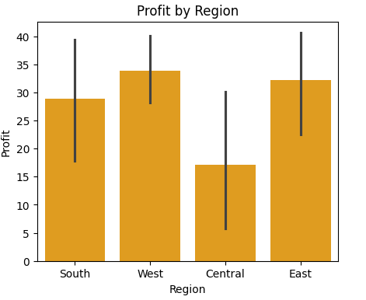
Regional Performance:-
West region generates highest profit
South region needs performance improvement

Slide 9
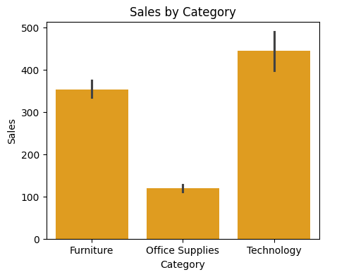
Sales by Category:-
Technology contributes highest sales
Office Supplies sells frequently but lower profit margin

Slide 10
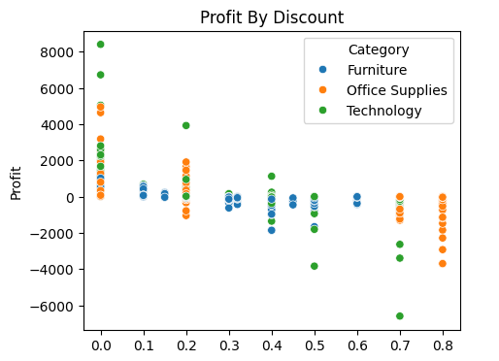
Discount vs Profit:-
Higher discounts → Lower profits
Controlled discount strategy recommended

Slide 11
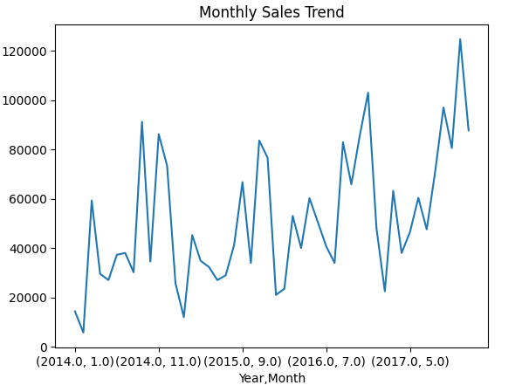
Monthly Sales Trend:-
Sales increase during year-end (Nov–Dec)
Lowest during mid-year (May–June)

Slide 12
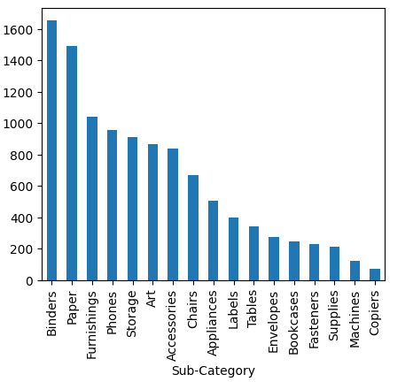
Top Products:-
Most sold: Binders, Phones
Most profitable: Copiers, Chairs

Slide 13
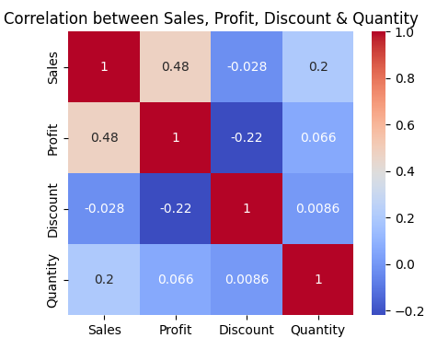
Correlation Between Numerical Quantities:-
Sales and Profit show a moderate positive correlation, meaning higher sales generally lead to higher profit.
Discount has a negative correlation with Profit — heavy discounts reduce profitability.
Quantity has only a weak correlation with Profit, showing that selling more units doesn’t always increase profit.

Slide 14
Key Insights:-
✅ Technology = Most profitable category ✅ West = Best-performing region ✅ Excess discount reduces profit margin ✅ Consumer = Most valuable segment

Slide 15
Recommendations:-
Reduce discount rates in Technology category
Focus marketing in South region
Promote top-performing products
Maintain stock of high-selling items

Slide 16
Conclusion:-
The analysis highlights that improving discount control and targeting underperforming regions can significantly enhance profitability.

